Slide 1
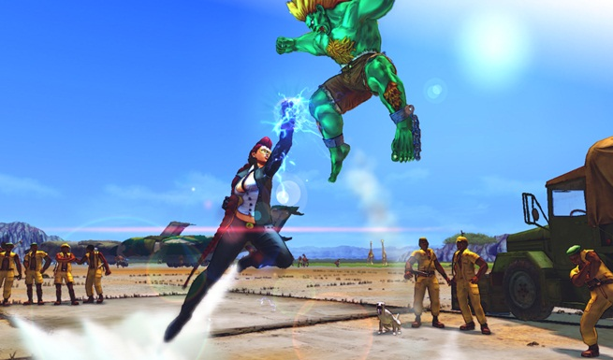
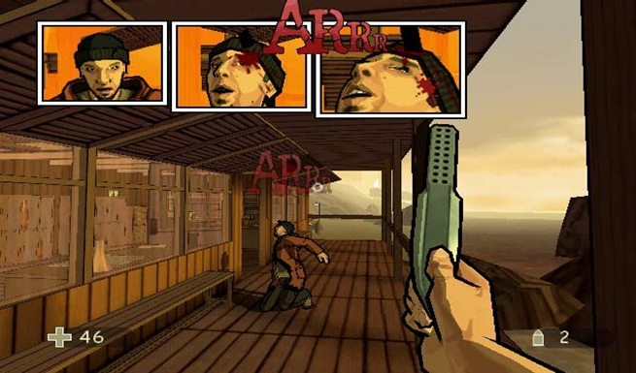
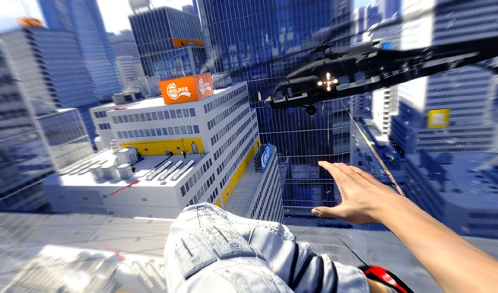
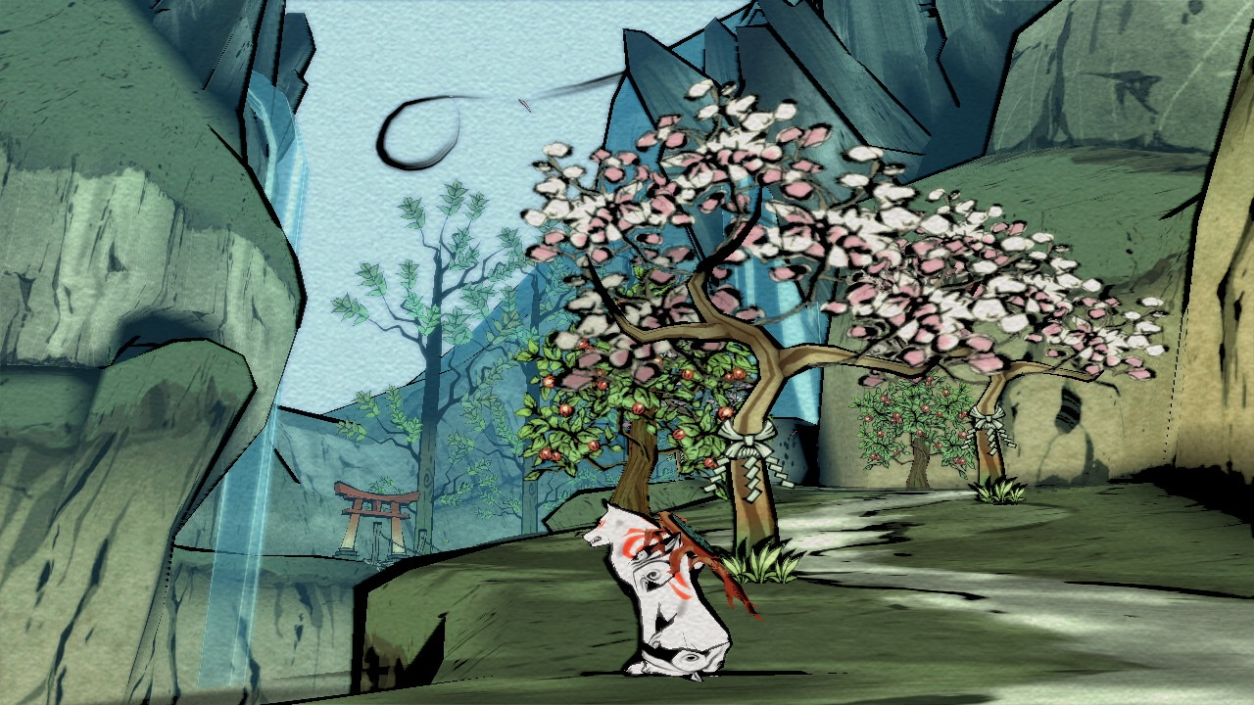
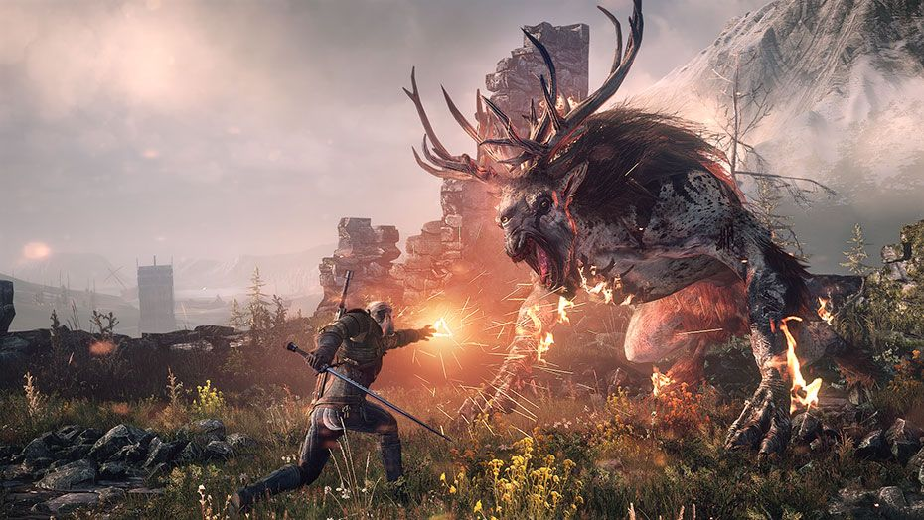
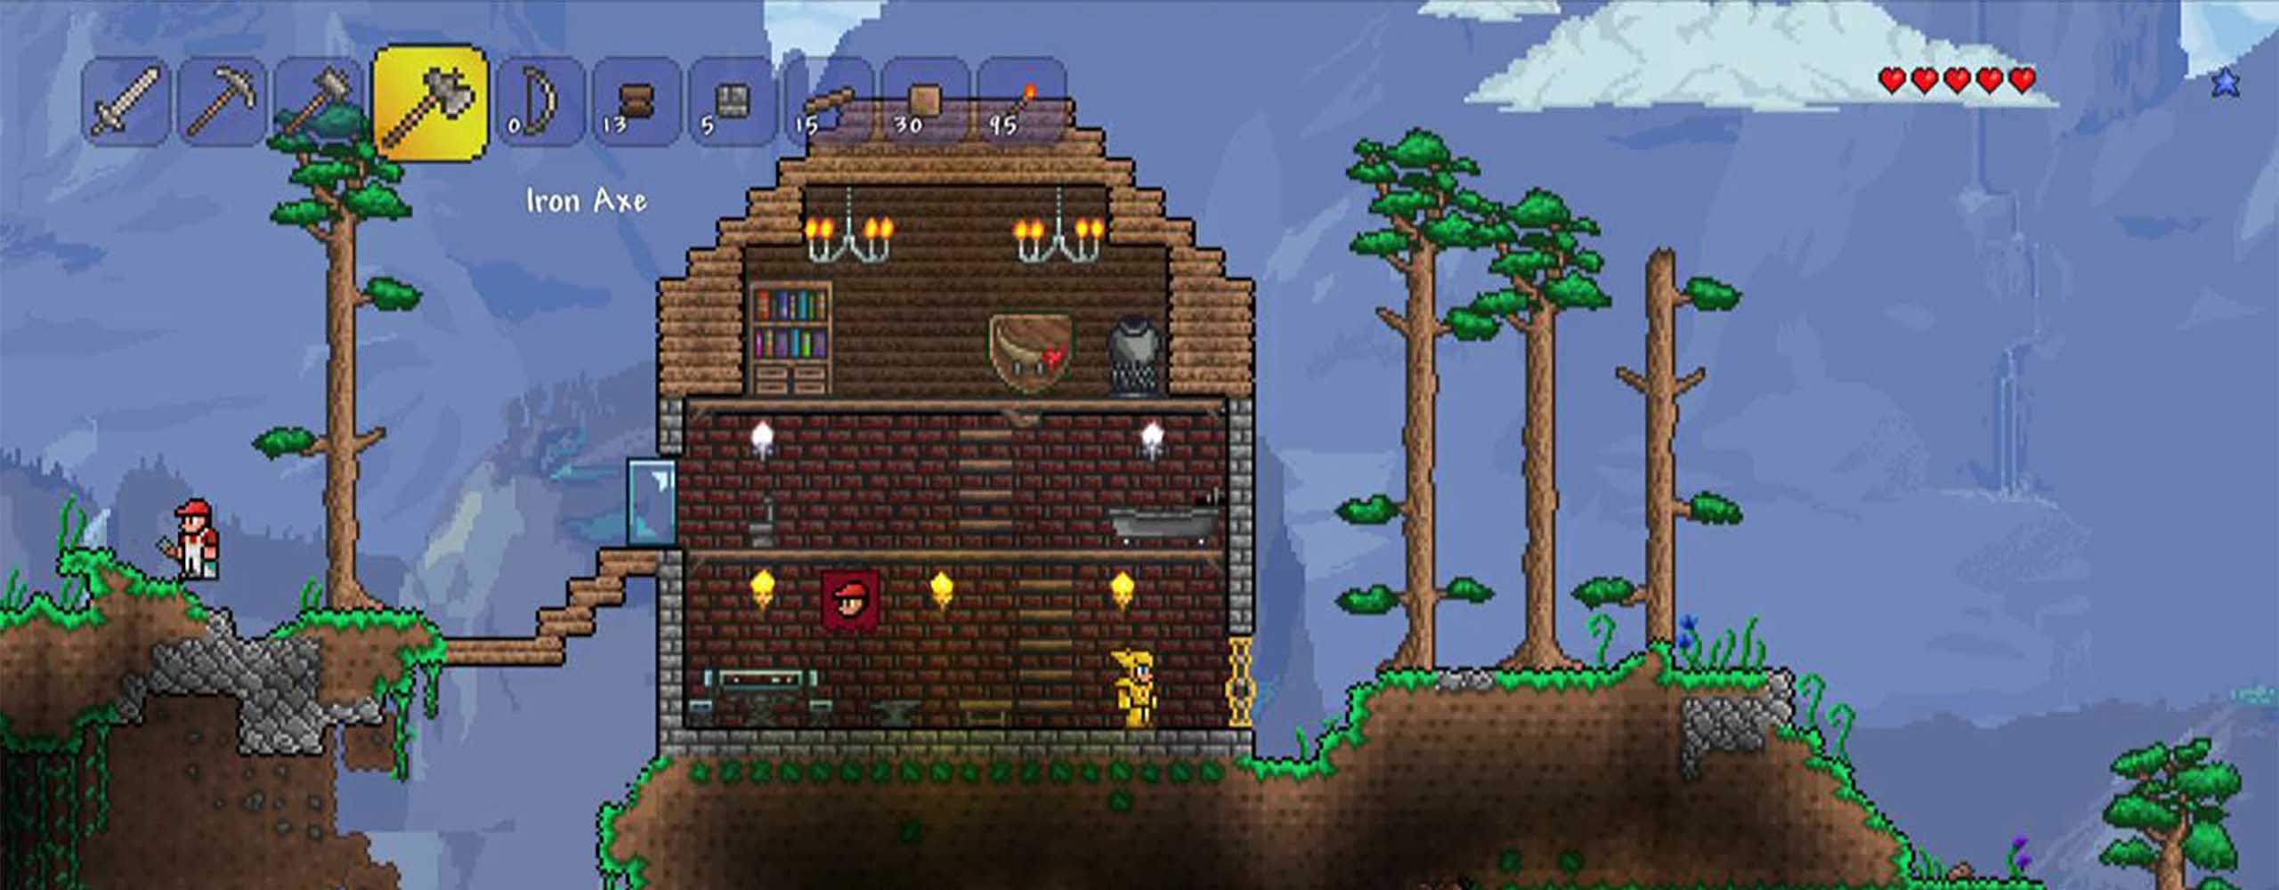
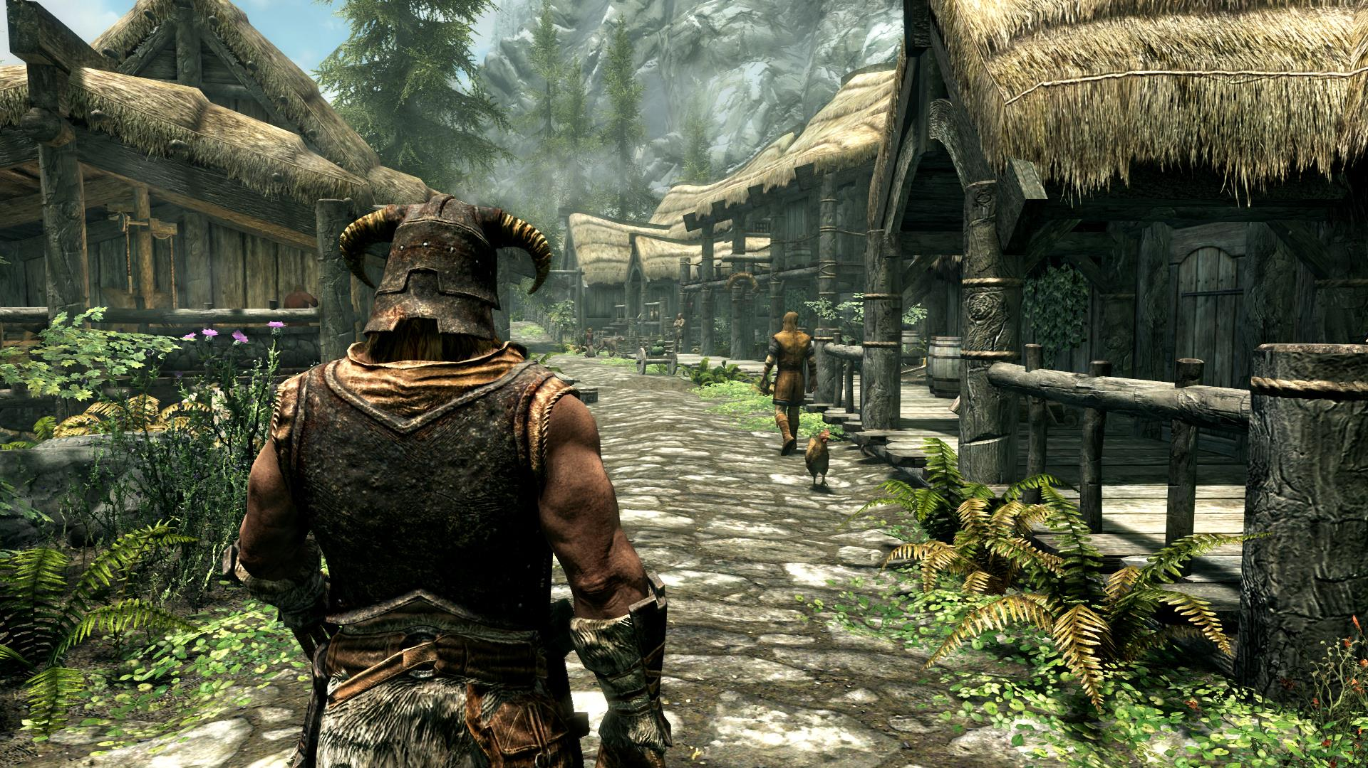
Street Fighter 4. Unique cel-shading style.
XIII. Comic book graphical style.
Mirror’s Edge. Polished and clean graphical style to immerse the player in its modernised era gameplay.
Okami. Oriental style, thick black outlines with an unusual perspective.
Terraria. A pixel art game from a side perspective.
Similar to Skyrim, however more details. Similar to middle ages era look.
Skyrim. Semi-realistic, fantasy graphical style.

